Slide 1
Editor Tutorial and 3x3 Advanced Cross
COLL 134
Week 3

Slide 2
Online Cube Simulators
alg.cubing.net
alpha.twizzle.net/edit
cubedb.net

Slide 3
Simulator Features
Setup/Scramble – input notation to place cube in predetermined state
Moves – input notation to manipulate cube, these are used to calculate move count and generate animations
Comments – insert forward slash “/” to comment on notation
Animations – play back moves, scrub individual moves, skip between initial and final states
Puzzle customization – change puzzle type and color scheme of desired simulation

Slide 4
Simulator Characteristics
No “drag-and-drop” or “click-and-hold” moving with cursor
Must use notation to manipulate simulations
!!!! – face color and face letter assignment are not connected
Standard position – white is U and green is F

Slide 5
Advanced Cross
Disregard centers
Solve multiple cross edges at once
Take advantage of pre-positioned edges

Slide 6
Foundations
Familiarity with color scheme is mandatory
Opposite colors:
Blue ←→ Green
Orange ←→ Red
Adjacent colors:
← Blue ←→ Red ←→ Green ←→ Orange →

Slide 7
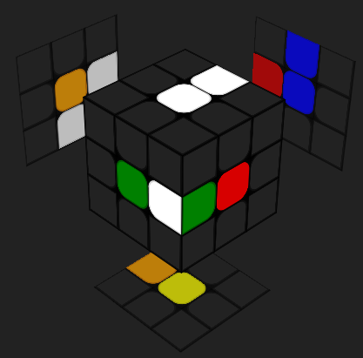
Foundations
“Correct” orientations are relative / dependent on perspective
Consider the white-green edge:
Its orientation is flipped, according to the green center
Its orientation is correct, according to the red center

Slide 8
Cases
Example 1: 1 piece misplaced
Set-up: L B R2 U’ B F’
Example 2: 3 pieces misplaced
Set-up: L F2 L’ U’ R U’
Example 3: 3 pieces solved, 4th piece attached to solved piece
Set-up: R2 D’ U F’ U2
Takeaway: disregard centers when assembling cross
*Must remember positions of colors relative to each other

Slide 9
Cases
Example 4: 1 piece flipped in bottom layer
Set-up: L2 B2 F R’ D’
Example 5: 1 piece flipped in top layer
Set-up: U L U’ F
Example 6: all pieces in correct place but flipped
Set-up: U R2 F B R B2 R U2 L B2 R U' D' R2 F R' L B2 U2 F2 (superflip algorithm)
Takeaway: pay attention to “good” and “bad” orientations of edge pieces

Slide 10
Cases
Example 7: 1 piece misplaced, 1 piece flipped
Set-up: B2 D F L’ F L D’ L2 D
Takeaway: use piece insertions to remove other misplaced pieces

Slide 11
Walkthroughs
Scramble 1: D' F2 U' R2 D' B2 L2 R2 U2 L2 B R' U L' B2 R2 D2 U2 B’
Solution: F' D' F' R U2 F’ R2
Scramble 2: F2 U2 L2 F2 U' L2 D R2 F2 U R2 F2 R' F' U' B' D' U2 F U2 L
Solutions: L' F' D' F' R B U2 or R L' B F2 U F U
Scramble 3: B R2 D2 R2 U2 B U2 R2 B2 F2 R2 F' U' R B F D R2 F D' U’
Solutions: U' B F' L' F2 U’ or U' S U' F2 R’ (more optimal)

